Slide 1
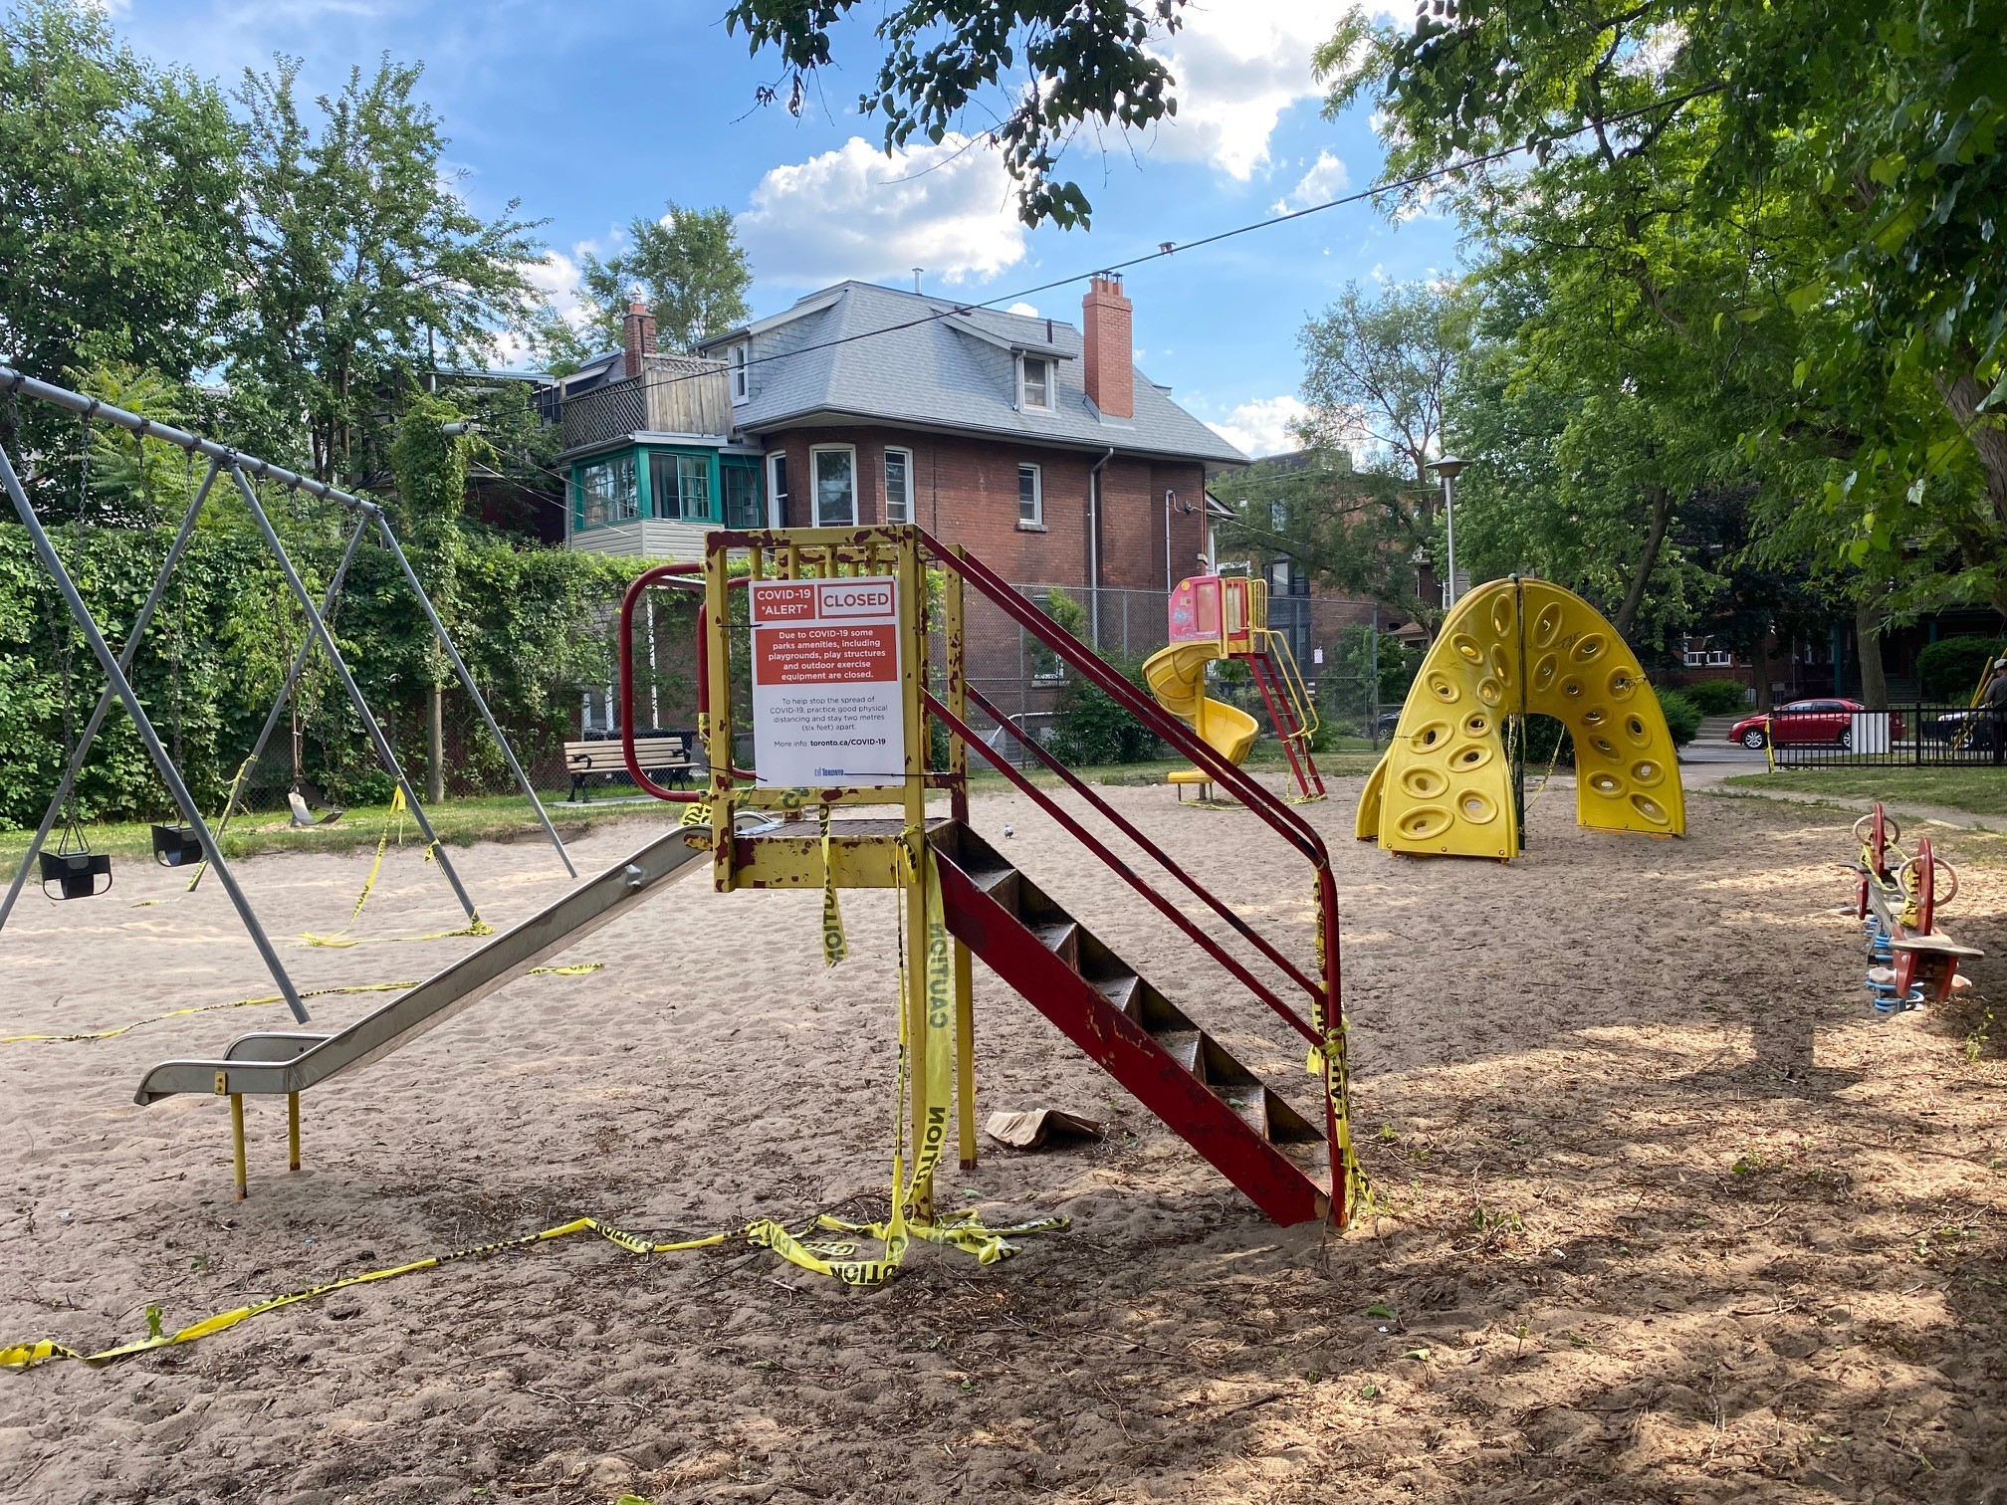
Activity Book Introduction
MY PARK AND PLAYGROUND REDESIGN - ACTIVITY BOOK
JOSEPH BURR TYRRELL PARK AND PLAYGROUND
The City of Toronto wants you to help redesign Joseph Burr Tyrrell Park & Playground!
Instructions: Print this activity book, or complete it online. Once you are done, ask your parent or guardian to submit your design through this submission page by July 20, 2020.

Slide 2
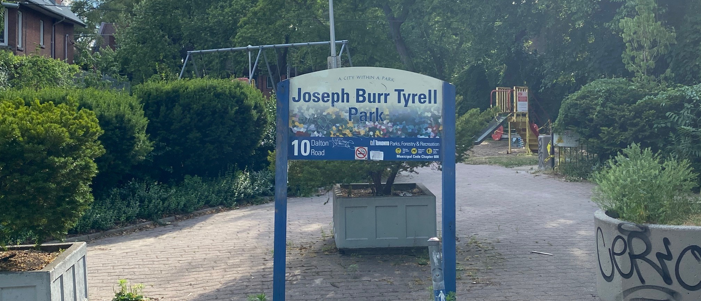
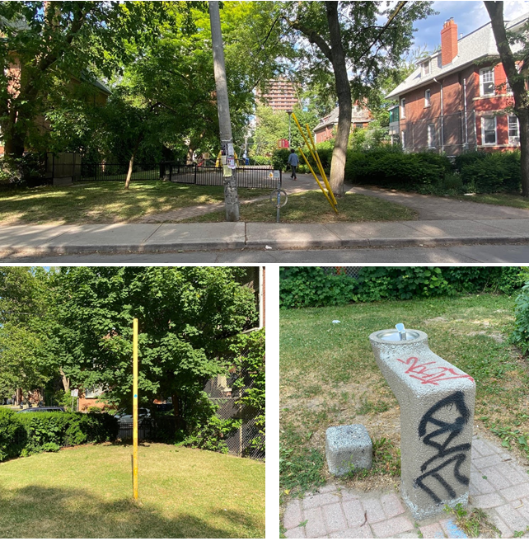
The Park Today - Photos
JOSEPH BURR TYRRELL PARK AND PLAYGROUND - TODAY
This is what Joseph Burr Tyrrell Park and Playground looks like today:
1
8
9
5
6
7
10
2
1. Park sign & entrance one
2. Park entrance two
3. A tetherball pole
4. A water fountain
5. A swing set
6. Benches
7. A small metal slide
8. A large spiral slide
9 A climbing activity
10. A seesaw
3
4

Slide 3
The park today - questions
JOSEPH BURR TYRRELL PARK AND PLAYGROUND - TODAY
What do you like about Joseph Burr Tyrrell Park and Playground, as it is today?
_______________________________________________________________________________________
_______________________________________________________________________________________
_______________________________________________________________________________________
What don’t you like about Joseph Burr Tyrrell Park and Playground, as it is today?
_______________________________________________________________________________________
_______________________________________________________________________________________
_______________________________________________________________________________________
What is missing from Joseph Burr Tyrrell Park and Playground? What would you like to add?
_______________________________________________________________________________________
______________________________________________________________________________________________________________________________________________________________________________

Slide 4
Your vision for the park - instructions
JOSEPH BURR TYRRELL PARK AND PLAYGROUND - MY VISION
Next, draw your vision for the new Joseph Burr Tyrrell Park and Playground!
These are some questions to think about before you design your park and playground:
Who will use the park?
What will people do in the park?
How will people walk or roll through the park?
How can I make sure the park is welcoming for people of all ages and abilities?
Where will people sit in the park?
What features will the playground have? (for example, will it have a slide, swings, a play structure, or other features?)

Slide 5
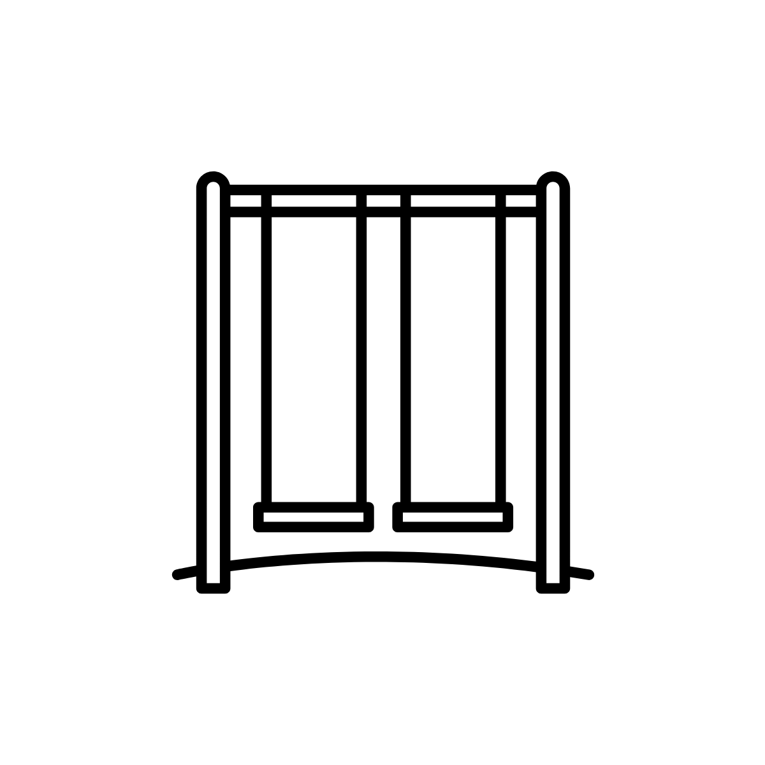
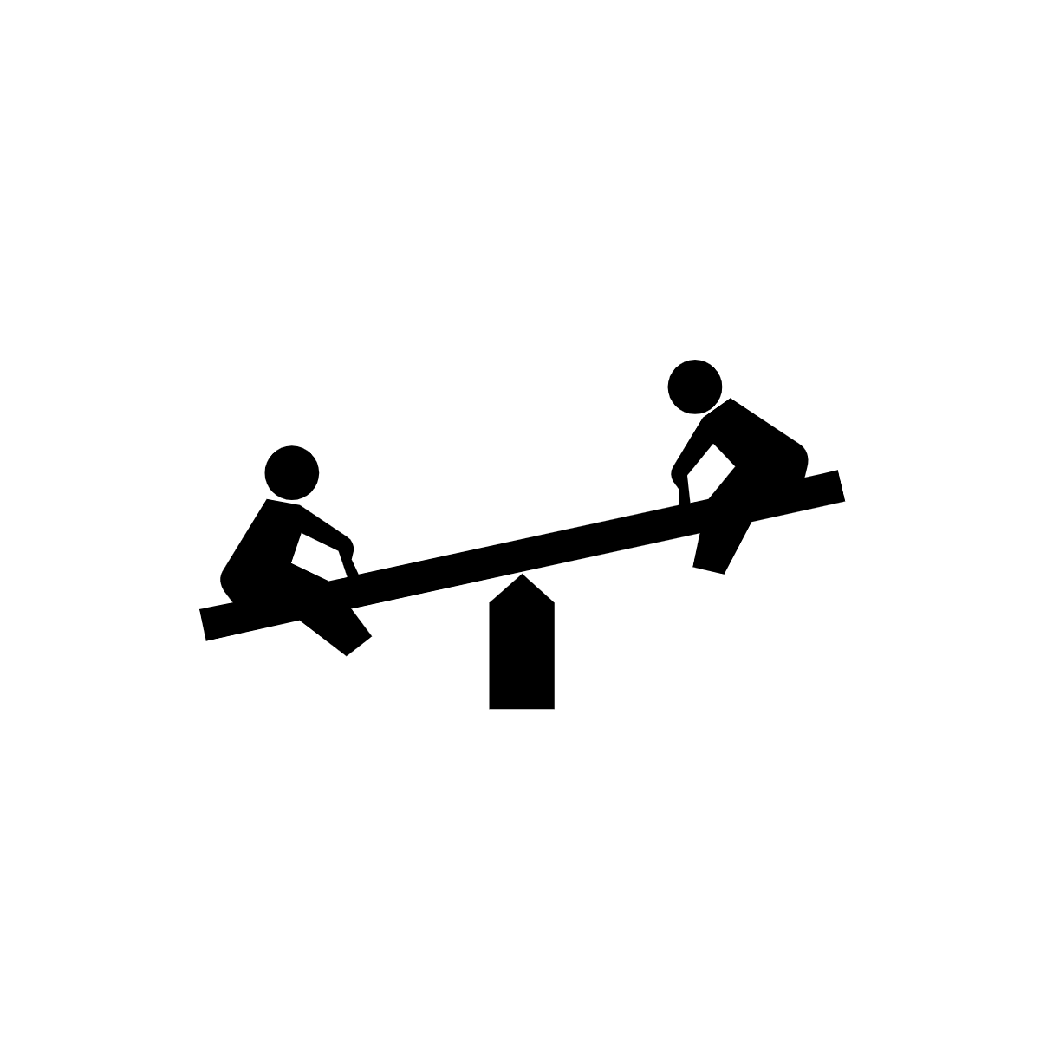
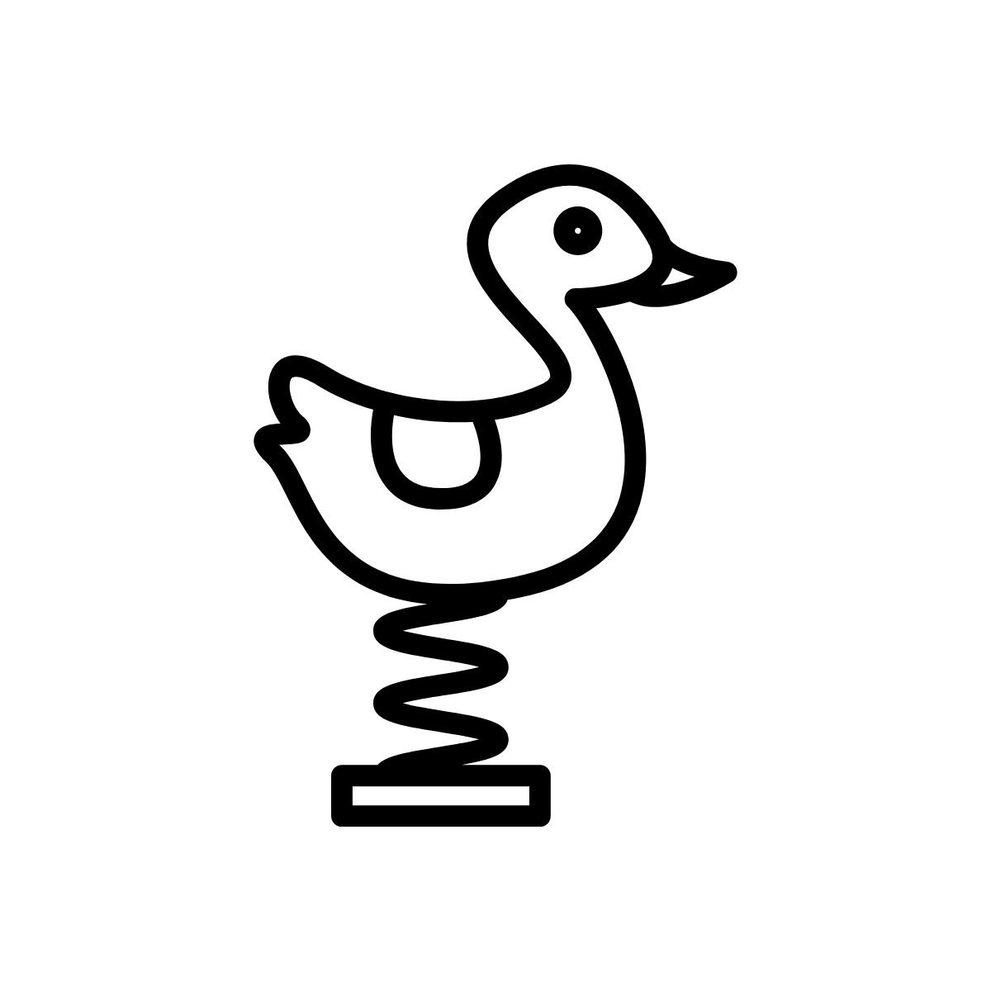
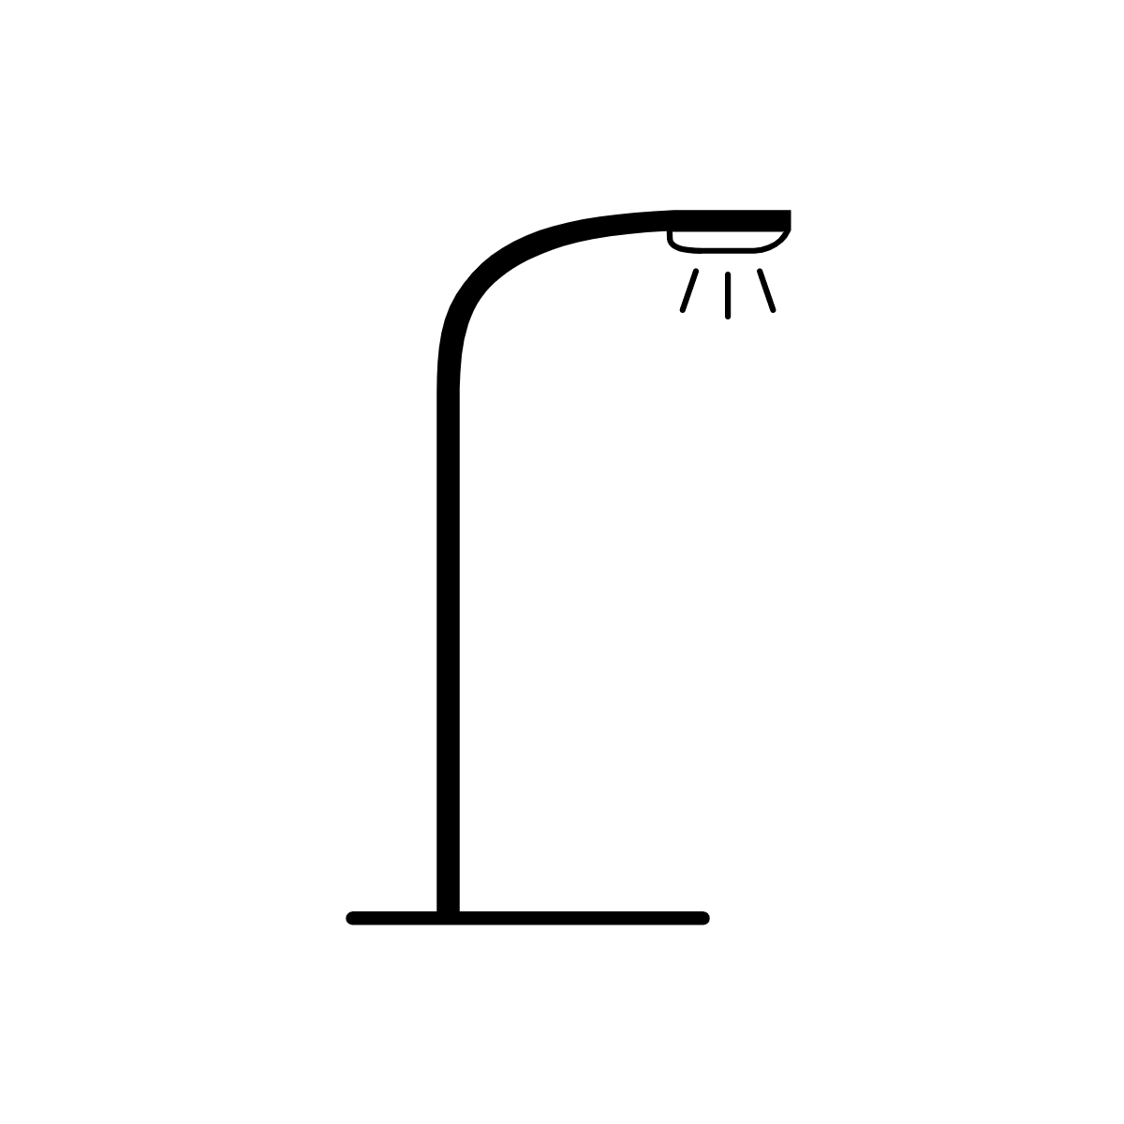
Your vision for the park - cutouts
JOSEPH BURR TYRRELL PARK AND PLAYGROUND - MY VISION
You can cut and paste the following features into your design to get you started, or draw your design by hand.
SLIDE
SEESAW
SWINGS
TREE
LARGE PLAY STRUCTURE
SPRING TOY
PARK SIGN
FLOWERS AND SHRUBS
SPIRAL SLIDE
DRINKING FOUNTAIN
LIGHTS
BENCH
CLIMBING STRUCTURE
SAND BOX
PLANTER
PICNIC TABLE

Slide 6
Your vision for the park – drawing page
JOSEPH BURR TYRRELL PARK AND PLAYGROUND - MY VISION
Draw your vision for the park and playground here!

Slide 7
Your vision for the park - written
JOSEPH BURR TYRRELL PARK AND PLAYGROUND - MY VISION
Tell us about your park design!
My park design includes:
Thank you for completing the Activity Book! Ask your parent or guardian to submit your design through this submission page by July 20, 2020.

