Slide 1
Elections 101
toronto.ca/elections

Slide 2
Elections 101: Overview
This presentation will help guide you through and the three main pillars of municipal elections in the City of Toronto:
Learn
Vote
Participate

Slide 3
Learn

Slide 4
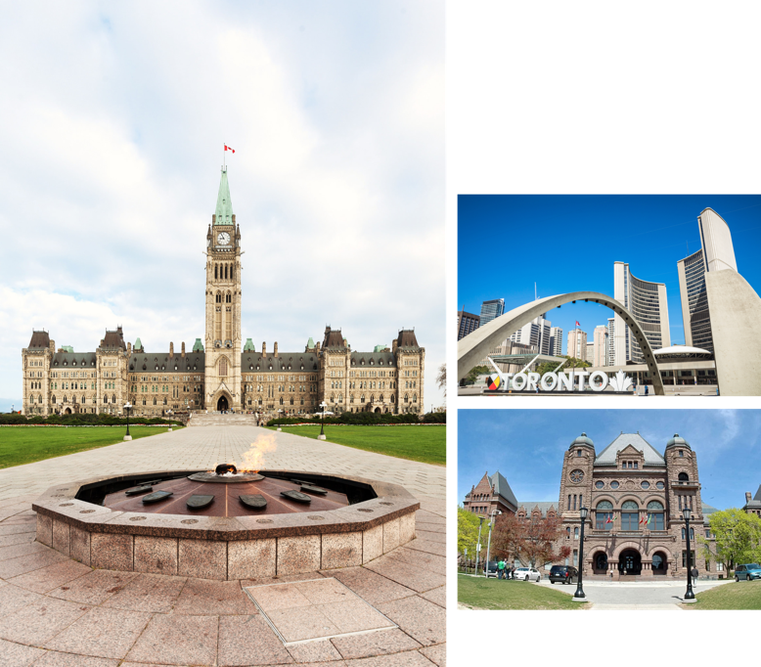
Levels of Government
Municipal: City of Toronto
Federal: Government of Canada
Provincial: Government of Ontario

Slide 5
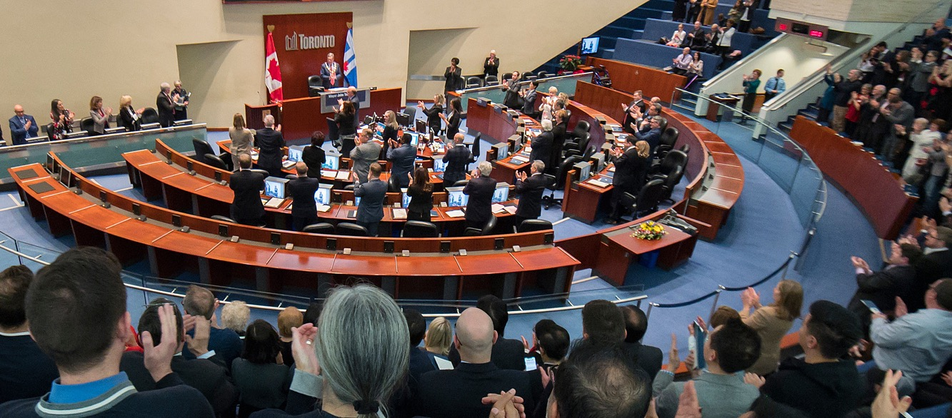
City Council
City Council is made up of 26 members:
1 Mayor
25 Councillors

Slide 6
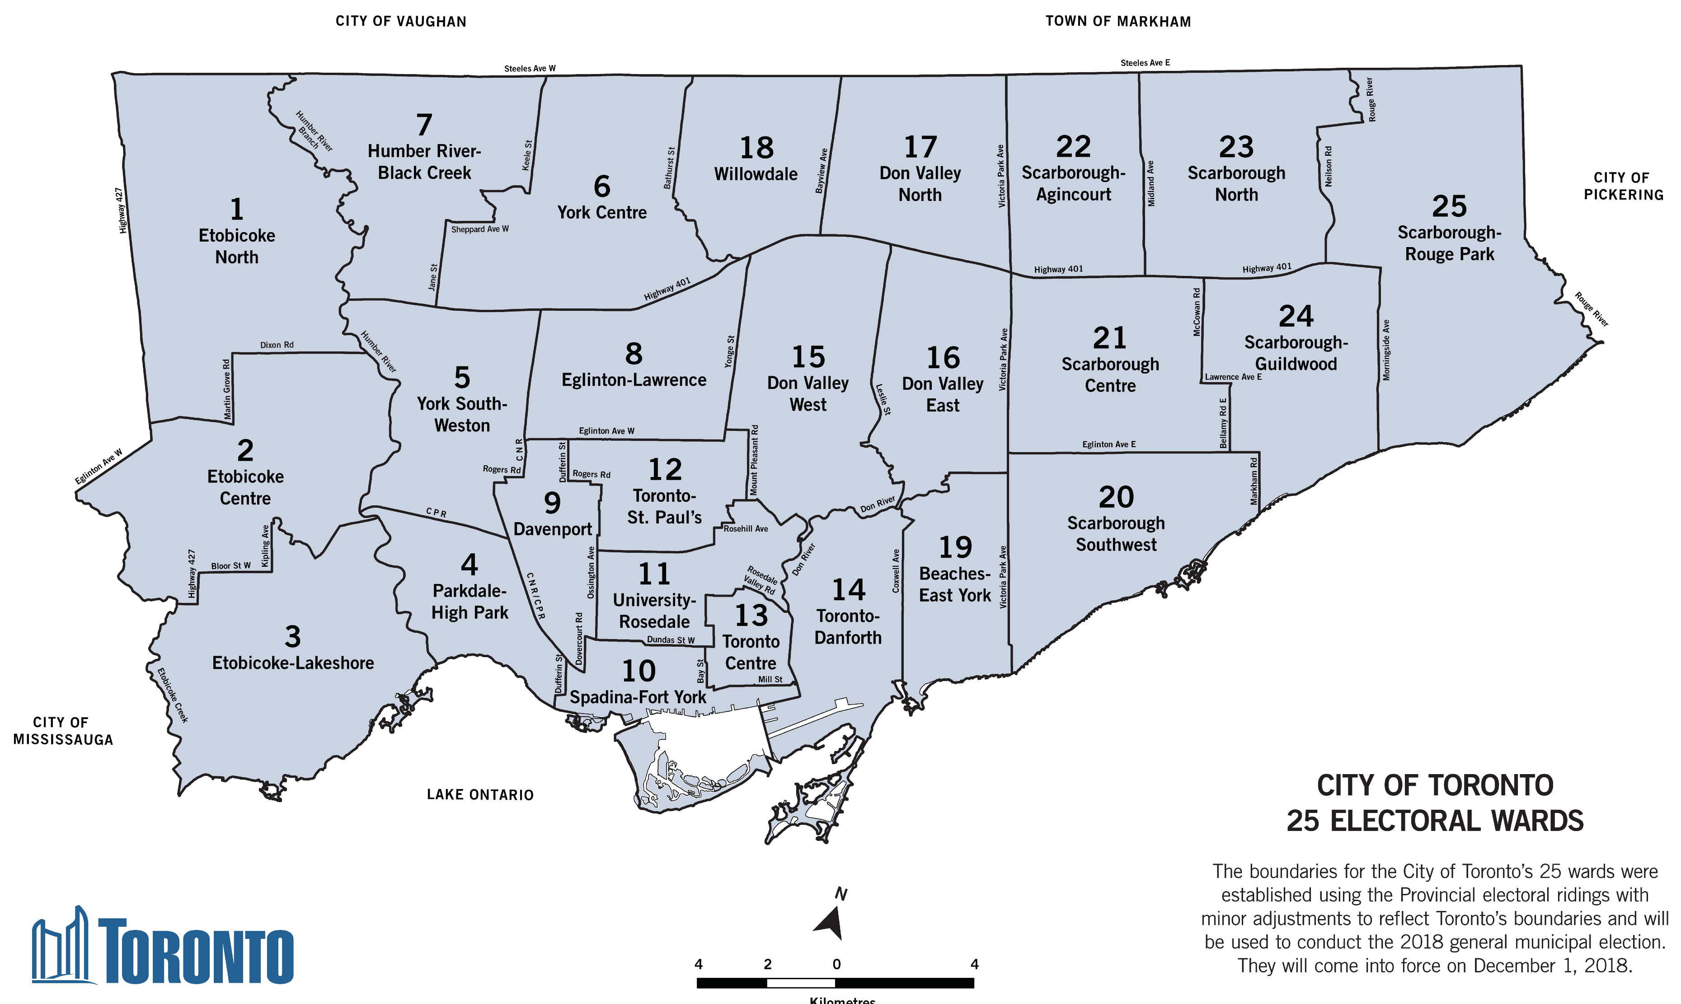

Slide 7
The Role of the Mayor
The Mayor:
Provides leadership to City Council
Represents Toronto across Canada and around the world
Works with different levels of government
Chairs the Executive Committee
Appoints councillors to chair the standing committees of City Council

Slide 8
The Role of Council
Councillors:
Talk to residents, businesses and community groups about City programs and access City services
Attend City Council and committee meetings
Sit on the boards of City agencies and corporations
Propose changes to the decisions City Council makes
Introduce motions to propose action or raise awareness of issues
Hold or attend community meetings to get input from the public
Host or get involved in community events

Slide 9
School Board Trustee
School board trustee’s are not officers of the City of Toronto. Toronto Elections administer the Trustee elections on behalf of the four school boards:
English Public: Toronto District School Board
English Catholic: Toronto Catholic District School Board
French Public: Conseil scolaire Viamonde
French Catholic: Conseil scolaire catholique MonAvenir
You can find more information from the Ministry of Education.

Slide 10
City Clerk
The City Clerk is responsible for the administration of municipal elections in the city of Toronto.
Responsibilities include:
To elect government
To make government work
To promote open government

Slide 11
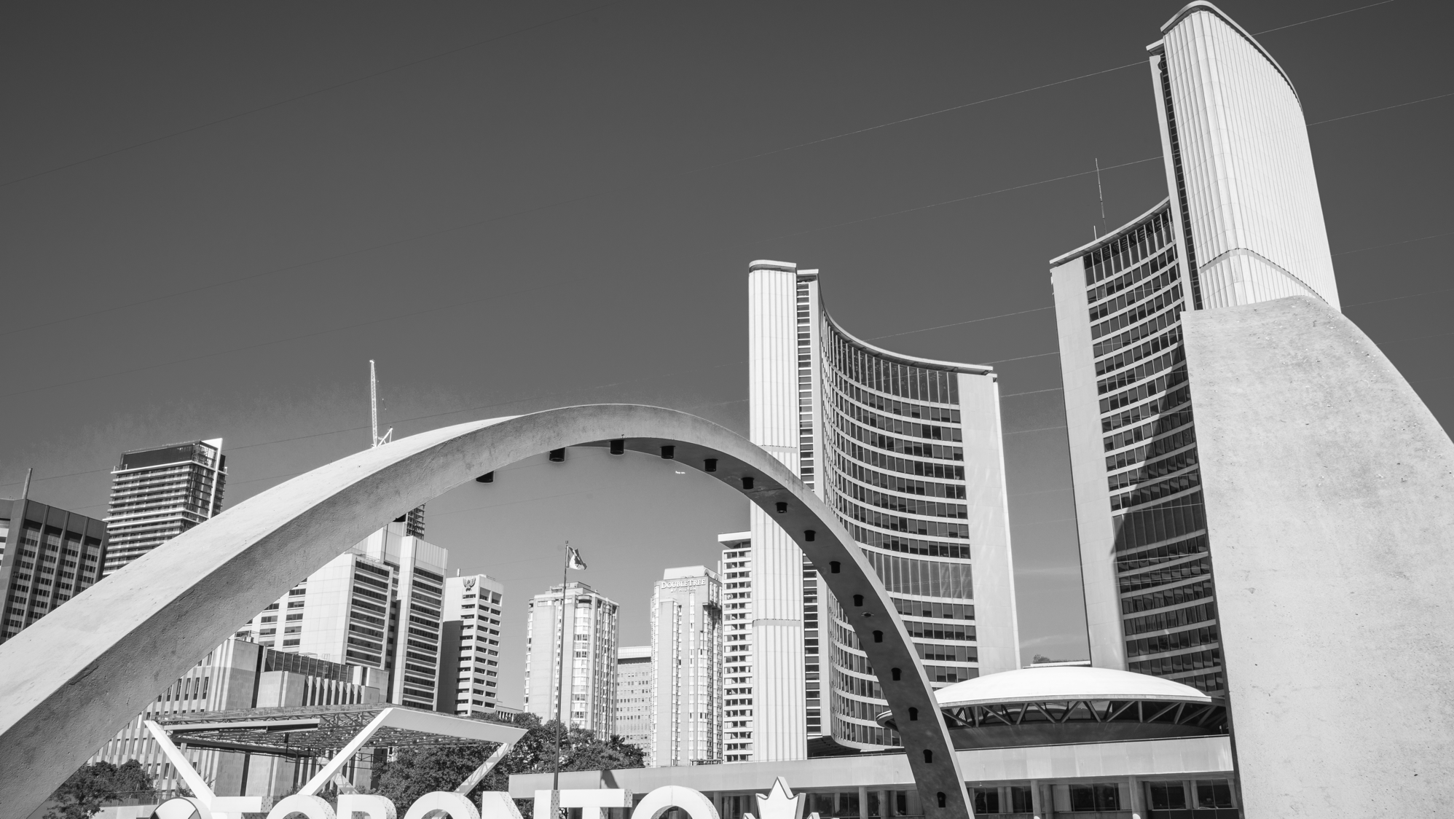
Vote

Slide 12
Who Can Vote
You are eligible to vote in the city of Toronto municipal election, if you meet all the following requirements:
You are a Canadian citizen
You are at least 18 years old
You are not prohibited from voting under any law
You qualify to vote
There are three ways that you can qualify to vote in a Toronto municipal election:
As a resident elector
As a non-resident elector
As the spouse of a non-resident elector

Slide 13
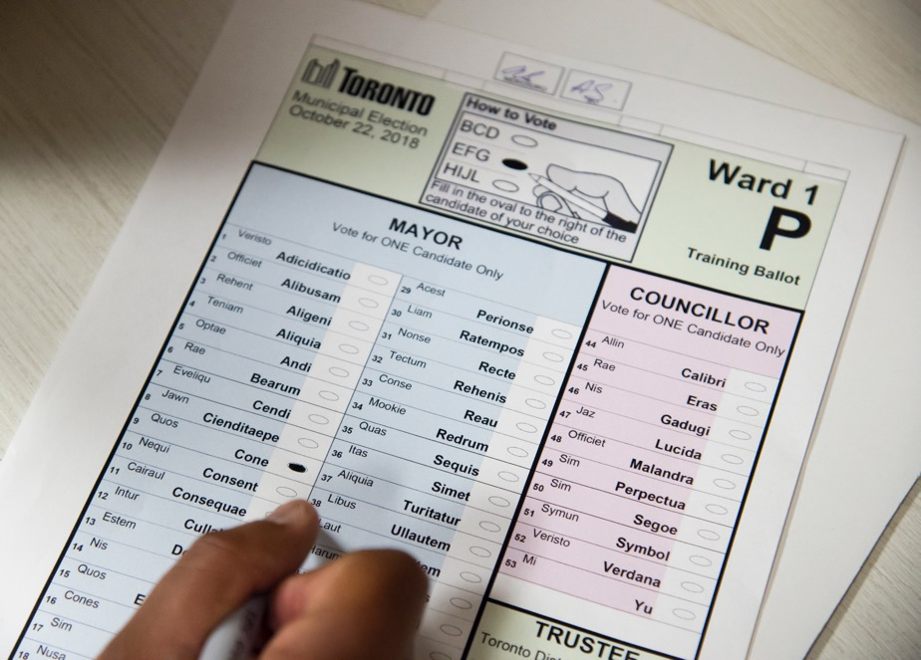
Who You Are Voting For
Eligible voters can vote for:
One candidate for mayor
elected city-wide
One candidate for councillor
one elected in each of the 25 wards
One candidate for school board trustee
one elected in each of the 4 school boards within each ward

Slide 14
Voters’ List
Your name must be on the voters’ list in order for you to cast a ballot. The voters’ list for each municipal election is prepared from data kept by the Municipal Property Assessment Corporation (MPAC).
Adding Your Name to the Voters’ List
You can check to see if MPAC has your information in its database at voterlookup.ca. You can also call them at 1-866-296-MPAC (6722) or TTY: 1-877-889-MPAC (6722).
The Voters’ List Becomes Official on September 1
After September 1, you will be able to check if you are on the voters’ list and make changes directly through MyVote until the close of voting on Election Day to apply for any changes.

Slide 15
Identification (ID)
When you go to vote you must show identification that shows your name and Toronto address. Photo identification is not required. Examples of identification include:
Ontario driver’s licence
Ontario health card (if your name and address are printed on the card)
mortgage, lease or rental agreement
bill for hydro, water, gas, telephone, Internet
A Canadian passport is not an acceptable identification document because you write your address inside your passport yourself.
See the full list of acceptable identification on toronto.ca/elections.

Slide 16
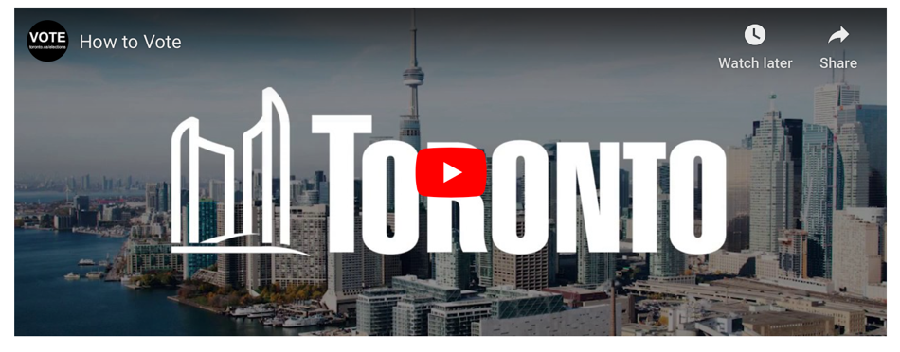
How to Vote
Show your ID and Voter Information Card
Your name is crossed off the Voters’ List
You will receive a ballot and secrecy folder
Mark your ballot behind the privacy screen by filling in the oval to the right of the candidate’s name
Place your marked ballot back in secrecy folder and give to the Election Official
The election official will feed your ballot into the tabulator – once accepted you have successfully voted!

Slide 17
Additional Voting Options and the VAT
Mail-in Voting
Appoint a Proxy Voter
Curbside Voting
Assistance in the Voting Place
Translated Materials and Language Services
Advance Vote
Voter Assist Terminal (VAT)

Slide 18
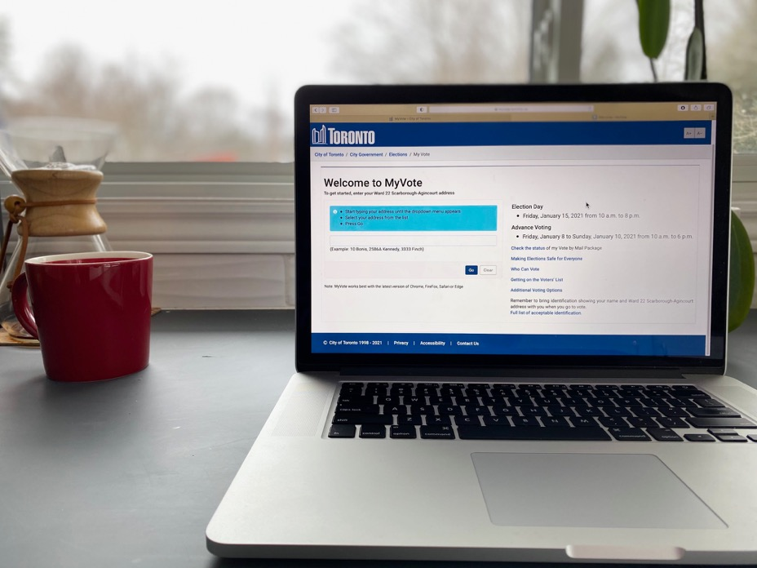
MyVote
Use MyVote to view key information specific to you the voter, and is easy to use, simply enter your Toronto address and you can:
Change, check or add your information to the voters’ list
Find out where and when to vote
View your voter information card
See the list of candidates
Find accessibility information about your voting place
And more!

Slide 19
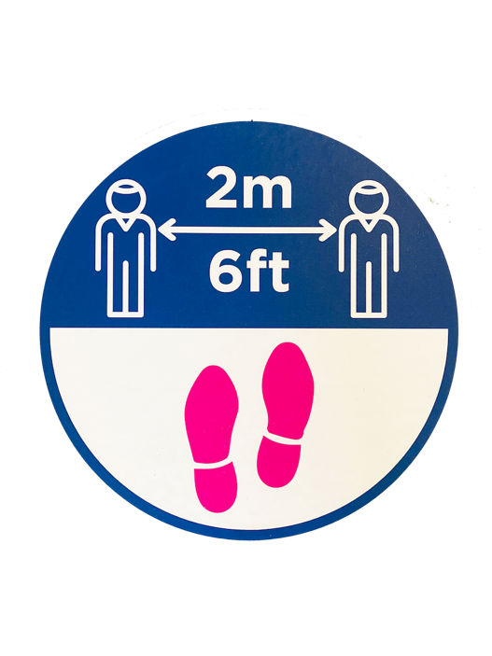
Making Voting Safe for Everyone
During the most recent by-election (January 2021), voting was carried out safely with the implementation of a range of health and safety measures:
Health Screening Officer Position
Maintaining Distancing, Occupancy and Ventilation Standards
Reduce Touch Points
Enhance Precautions for Election Day Workers
Provide Additional Options to Vote
Encourage Health and Safety for Electors Going to Vote

Slide 20
Participate

Slide 21
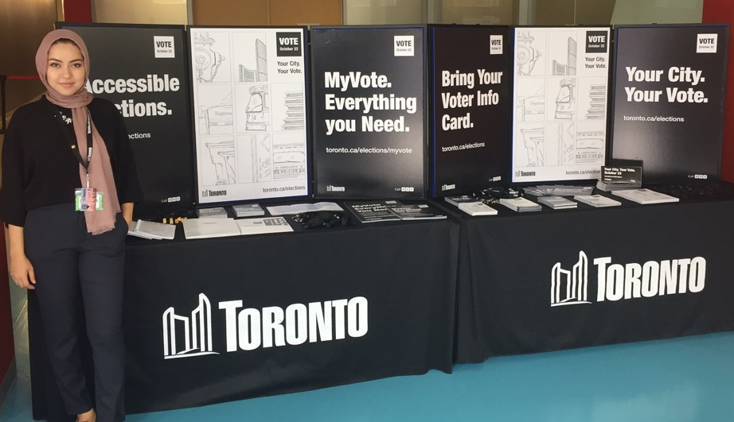
How to Get Involved
You Can:
Run as a candidate
Register as a Third Party Advertiser
Work the election
Share information to your community

Slide 22
Run as a Candidate
To run for mayor or councillor, on the day the nomination paper is filed, a person must be:
A Canadian citizen
At least 18 years of age
A resident of the City of Toronto, or
An owner or tenant of land in the City of Toronto, or the spouse of the owner or tenant
Not legally prohibited from voting
Not disqualified by any legislation from holding municipal office

Slide 23
Resources for Candidates
Information is always available on the Toronto Elections website: toronto.ca/elections
The Toronto Elections website includes resources such as:
Candidates’ Guides
Candidate Information Sessions
Links to the Municipal Elections Act
General questions are always welcome, email elections@toronto.ca or call 416-338-1111.

Slide 24
Third Party Advertising
The Municipal Elections Act, 1996 now includes rules for third party advertising.
A third party advertisement is a message in any medium that promotes, supports or opposes a candidate.
Third party advertising is separate from any candidate’s campaign, and must be done independently from a candidate.
A third party advertiser is required to register with the City Clerk of the municipality where they want to advertise.

Slide 25
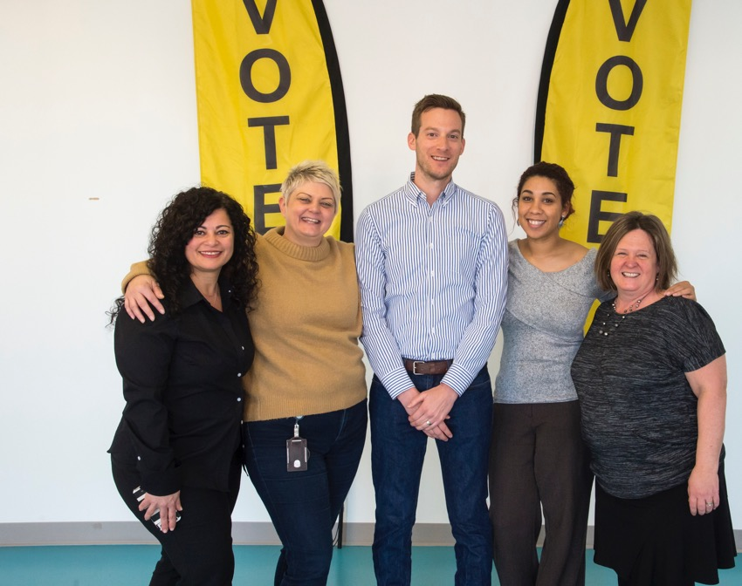
Work the Election
In 2018 over 15,000 people were hired as voting place staff.
Recruitment generally starts in the spring/summer of the election year.
Job descriptions will be available on the Toronto Elections website.
Applications can be submitted online.

Slide 26
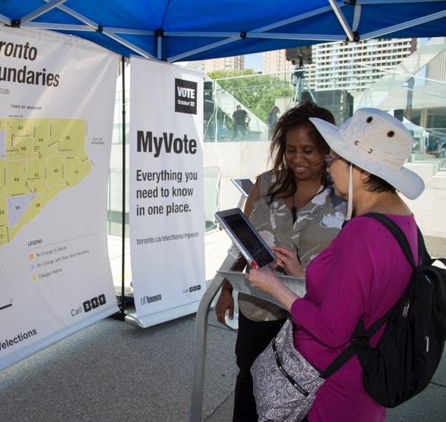
Share Information with your Community
Share this presentation and the information with your community.
Invite Toronto Elections to your events.
Join the Election Outreach Network.

Slide 27
Election Key Dates
The Nomination Period: May 2 – August 19 at 2 p.m.
Employment Opportunities: July - October
Third Party Advertiser Registration: May 2 – October 21
Voters’ List Registration (using MyVote): September – October
Mail-in Voting: September – October
Advance Vote: October 7 – 14
Election Day: October 24

Slide 28
Contact Us
Website:
www.toronto.ca/elections
Email:
elections@toronto.ca
Phone:
416-338-1111
Social Media:
facebook.com/electionservices
twitter.com/torontovotes
instagram.com/torontovotes
My Local Government is a great tool to learn about your local government and how to get involved:
toronto.ca/mygov

